Slide 1

Recommendation system for twitter user based on community
Jinfen li
Wenzhe yang
Jiaqi chen
Heli shah
Himani patel

Slide 2
SIGNIFICANCE
It is easy for two people to become friends if they share the same topics of interest or are most popular in the community or tweet in the same location coordinates as of the user or are in the same social community.

Slide 3
ABSTRACT
The project is about recommending a suitable friend to a Twitter user.
A friend would be recommended to a user if:
It has the same social community
If they are tweeting on similar topics
If they are popular in the community based on the centrality
If they are popular based on the followers or friends count
If they tweet nearby
Recommending hashtags based on the frequency in the same community

Slide 4

DATA COLLECTION
We take a starting user as the first node and crawl his/her friends or followers in order to make them level-1 nodes. We do the same procedure on the level-1 nodes to find level-2 nodes and so on.
This way, we collected a bunch of users on whom we can apply various tics and tacs mentioned above through which the users would be recommended.

Slide 5
Community detection
Two levels comparison
Network-Centric Community: Spectral clustering
Hierarchy-Centric Community: Louvain clustering
Compare method: which topic is more comprehensive

Slide 6
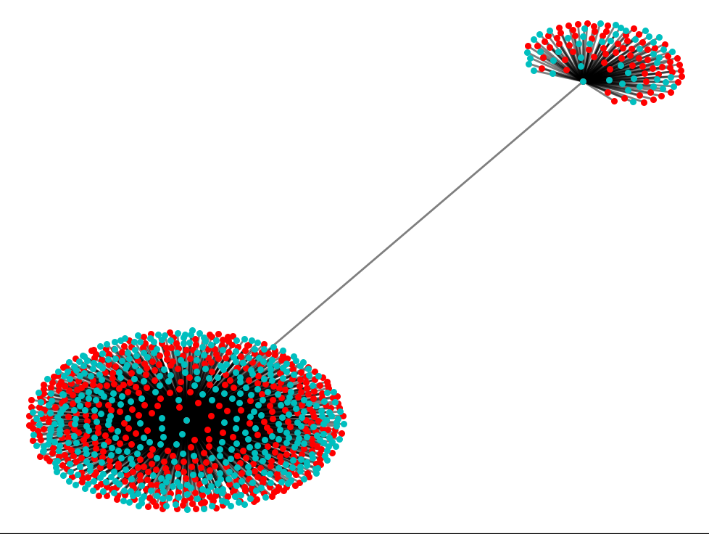
Spectral clustering
Spectral clustering is to find a best graph partition where the cut (to separate two disjoint graph) is minimized.
Calculate adjacent matrix A according to KNN
Calculate degree matrix D and Laplacian Matrix L according to A
Normalize L D^{-1/2}LD^{-1/2}
Calculate the eigenvalue of L, and get eigenmatrix H_{nm}
Apply Kmenas on H_{nm}
Get clustering result C = {C ₁, C₂ , …., C_{k}}
Community detection

Slide 7
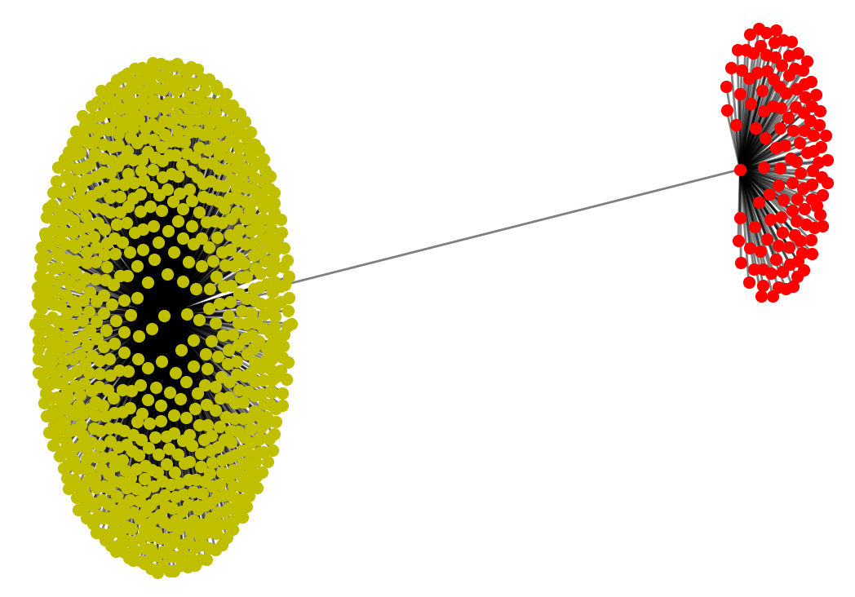
LOUVAIN
Phase 1
Treat every node as a community
Scan the neighboring node of each node and decide which community of its neighboring nodes to join based on the modularity criterion
Repeat the above steps until all the node found the fixed community
Phase 2 Then the modularity information of the new formed community is re-calculated, and the new-formed community is treated as a single node for further merge, and repeat phase 1

Slide 8
Which is better
LDA: the topic is more comprehensive in spectral clustering compare to Louvain clustering.
Louvain
1
2
3
4
Spectral

Slide 9
Recommend friends by Topics
Find users in the same community who share similar topics
similar means they have the same topic words
Topics are generate from each user’s latest 200 twitter
Using LDA algorithm to do topic modeling

Slide 10
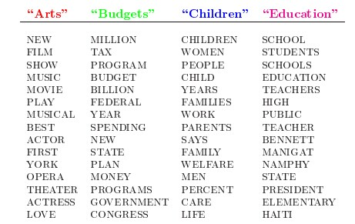
LDA topic modeling
a “generative probabilistic model” of a collection of composites made up of parts.
soft clustering composites and parts.
more nuanced way of recommending similar items rather than making each entity can only belong to one cluster.
Community detection

Slide 11
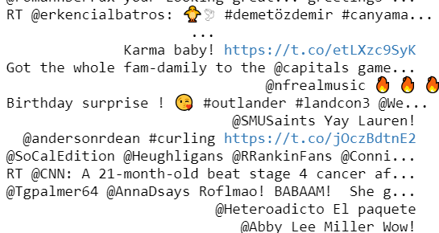
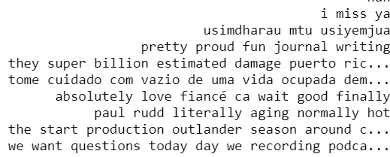
DATA PROCESSING
Clean the URL links and non-alphabetic words with regular expressing
NLTK Tokenize and filter the stop-words
NLTK.Lemmatization Stemming :
Reduce redundancy

Slide 12
PEOPLE WHO TWEETED NEAR THE USER
This feature of our recommendation system allows a user to find another user who tweeted near his/her location.
Here, we find the location of the user that is under consideration for recommendation.
Based on that location, we find all the recent tweets that are made at that particular location.
Then, we extract three tweets from a list of tweets on that location.
We recommend the profiles of these tweets to our current user in consideration.

Slide 13
Algorithm detail

Slide 14
followers and friends
Find users who have more followers or friends than others.
More friends means
more interested in socializing
more active in social activities
More followers means
The content which he tweet is more attractive in the history
He is more popular in the community,even a celebrity

Slide 15
centrality Based recommendation
Compare three kinds of Centrality
Degree Centrality
Betweenness Centrality
Closeness Centrality

Slide 16
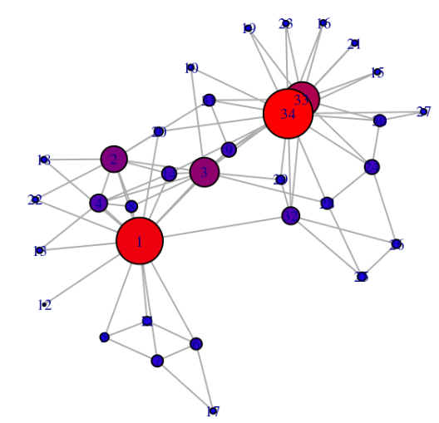
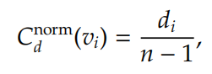
Degree Centrality
Focus on the quantity of friends and followers
The result of degree centrality based recommomendation is similar to “based on friends and followers”.
Community detection

Slide 17
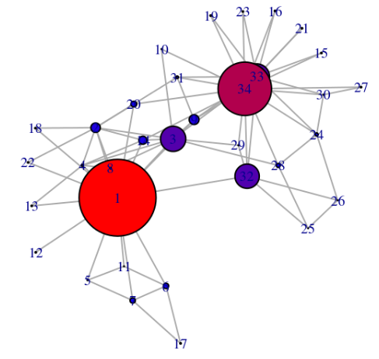
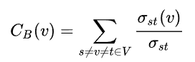
Betweenness Centrality
Focus on the “bridge” function in a graph
If we want to find a friend to make more friends through him,betweenness centrality will be a better choice
We want to find the one share more interesting and attractive tweets.So we choose another centrality “closeness”

Slide 18
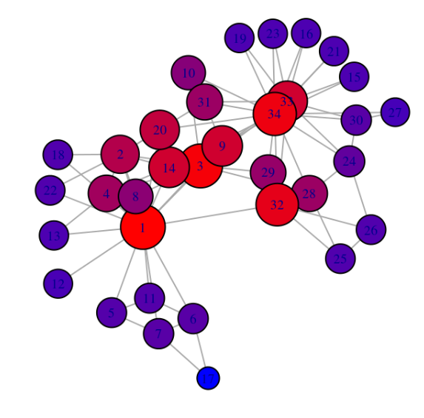
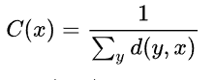
Closeness Centrality
The guy with the tag “closeness centrality” can get interesting information from anywhere in the community quickly.Once follow him,we can quickly know the events happen recently.
He is more likely to be your friend's friend.That is to say,you may share more topics with each other
We can use Floyd-Warshall algorithm to calculate the shortest path between those nodes.
We choose this centrality in our program

Slide 19
hash tag recommendation
We want to find some most frequently used hashtags in the community so that the users can choose from them
It changes all the time.We can use it to find out which event is the hottest one in the tweet recently
Based on the community detection.The user very likely interested in this event.We can recommend it to him
The method is to collect those words after “#” in tweets.Then count the total number of each hashtag.Find the maximum one.

Slide 20
hash tag (result)

Slide 21
Conclusion
The project is about recommending a suitable friend to a Twitter user.
A friend would be recommended to a user if:
It has the same social community
If they are tweeting on similar topics
If they are popular in the community based on the centrality
If they are popular based on the followers or friends count
If they tweet nearby
Recommending hashtags based on the frequency in the same community

